Slide 1
WEEKLY WORK PRESENTATION
FPGA • Verilog • PLL • Cortex-M3 • ESP32-S3
From KiCad schematic verification to FPGA programming, processor communication and a Wi-Fi web interface
DAY 1 KiCad + AXP2101 + ESP32-S3
DAY 2 FPGA Basics + Verilog
DAY 3 PLL + Frequency Detection
DAY 4 Cortex-M3 + FPGA Communication
DAY 5 ESP32-S3 Wi-Fi + Web Interface
Weekly objective: build and demonstrate the complete programming flow

Slide 2
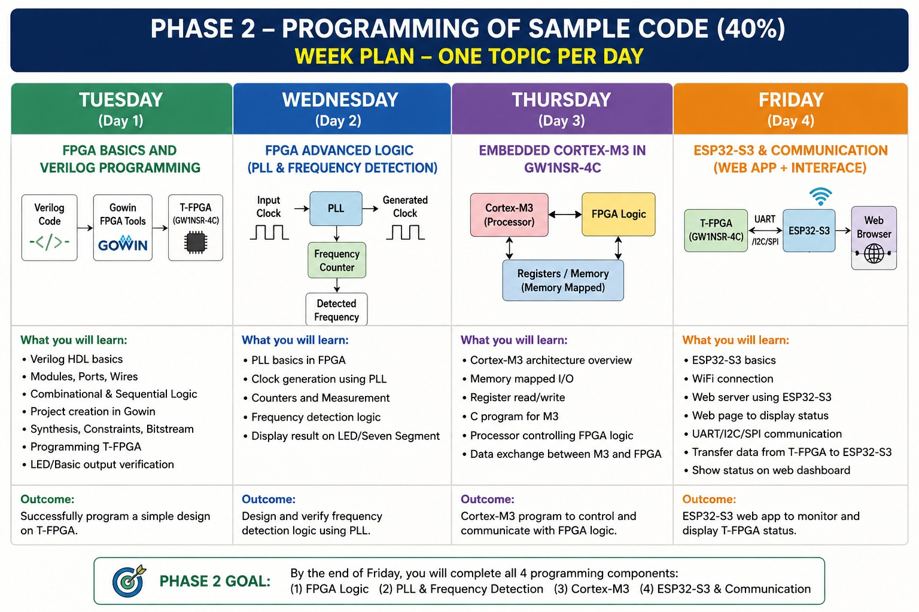
WEEK ROADMAP
MONDAY → FRIDAY
Five-day execution flow
MONDAY | Day 1
KiCad schematic review AXP2101 + ESP32-S3 Connection verification
TUESDAY | Day 2
FPGA basics Verilog implementation Gowin/T-FPGA flow
WEDNESDAY | Day 3
PLL basics Clock generation Frequency detection
THURSDAY | Day 4
Cortex-M3 Memory-mapped registers FPGA communication
FRIDAY | Day 5
ESP32-S3 Wi-Fi UART/I²C/SPI Web dashboard

Slide 3
DAY 1 – MONDAY
KiCad Schematic Review & Verification
WHAT I WORKED ON
SCHEMATIC FLOW
• Reviewed the AXP2101 power-management schematic in KiCad.
• Reviewed ESP32-S3 schematic symbols, pins and external connections.
• Verified power, ground and interface connections before moving to system integration.
• Checked schematic connectivity and ran ERC to identify electrical issues.
• Reached 0 ERC errors; remaining warnings were treated as non-blocking after review.
AXP2101 Power
Power Rails & GND
ESP32-S3 Controller
Interface Nets UART / I²C / SPI
Verification focus
Key result
Presentation evidence
• Pin-to-pin connectivity • Power and ground nets • Interface signal naming • ERC error checking
KiCad schematic was reviewed and electrical connectivity was verified as the starting point for the programming phase.
Insert screenshots of: 1) AXP2101 schematic 2) ESP32-S3 schematic 3) ERC result window
Outcome: a verified hardware-level starting point for the FPGA + ESP32-S3 programming workflow.

Slide 4
DAY 2 – TUESDAY
FPGA Basics & Verilog Implementation
LEARNING & WORK
FPGA PROGRAMMING FLOW
• Understood the basic FPGA programming flow using Gowin tools.
• Worked with the T-FPGA based on the GW1NSR-4C device.
• Reviewed Verilog HDL modules, ports, wires and logic structure.
• Implemented basic combinational and sequential logic.
• Prepared synthesis, constraints and bitstream generation flow.
• Programmed the T-FPGA and verified a basic LED/output design.
Bitstream
T-FPGA Program
Verilog Code
Gowin Project
Synthesis & P&R
LED / Output Verify
Verilog concepts
Tool flow
Modules • Ports • Wires Combinational logic Sequential logic
Project creation Constraints Synthesis → bitstream Device programming
Outcome
Successfully moved from HDL source to a programmable FPGA design and basic output verification.
Evidence to show: Gowin project, Verilog source, synthesis/programming window, and LED/output result.

Slide 5
DAY 3 – WEDNESDAY
PLL & Frequency Detection
CONCEPTS COVERED
IMPLEMENTED LOGIC
• PLL basics in FPGA clock management.
• Clock multiplication/division and generated clock concepts.
• Frequency counter design for measurement.
• Detection of an input or generated clock frequency.
• Displaying or verifying the detected result using FPGA outputs.
Input Clock
PLL
Generated Clock
Frequency Counter
LED / Seven- Segment Output
Detected Frequency
Why PLL?
Why frequency detection?
Outcome
Provides a controlled clock source for FPGA logic and makes clock-dependent designs easier to manage.
Demonstrates practical measurement of a clock signal using counters and timing logic.
Design and verification of frequency-detection logic using PLL-generated clocks.
Evidence to show: PLL configuration, Verilog logic, timing/measurement result, and output display.

Slide 6
DAY 4 – THURSDAY
Cortex-M3 & FPGA Communication
CORE TOPICS
SYSTEM ARCHITECTURE
• Cortex-M3 processor architecture overview.
• Memory-mapped I/O and register-based control.
• Register read/write operations from C code.
• Processor control of FPGA logic.
• Data exchange between the embedded processor and FPGA fabric.
Communication idea
Cortex-M3 Processor
FPGA Logic
1. C code runs on Cortex-M3 2. CPU writes/reads mapped registers 3. FPGA logic reacts to register values 4. Status/data can be read back
Registers / Memory Mapped
C program → register writes → FPGA action
Outcome
A processor-controlled FPGA subsystem in which software and programmable logic exchange control/status data through memory-mapped registers.
Evidence to show: Cortex-M3 block diagram, register map/code, and communication test result.

Slide 7
DAY 5 – FRIDAY
ESP32-S3 Wi-Fi & T-FPGA Web Interface
WORK COMPLETED
END-TO-END DATA FLOW
• Reviewed ESP32-S3 communication and Wi-Fi fundamentals.
• Established the concept of transferring T-FPGA status/data to ESP32-S3.
• Covered UART / I²C / SPI as possible hardware communication links.
• Used ESP32-S3 as the bridge between FPGA data and a browser-based interface.
• Designed the web-dashboard flow for displaying T-FPGA status.
T-FPGA GW1NSR-4C
ESP32-S3
Wi-Fi
UART / I²C / SPI
Web Browser
ESP32-S3 role
Web interface
Connect to Wi-Fi, receive FPGA data, host the web server and expose status to a browser.
Browser dashboard can show status values, detected frequency and other system information.
Outcome: an ESP32-S3 based web interface concept for monitoring and displaying T-FPGA status.

Slide 8
COMPLETE WEEK – INTEGRATED SYSTEM VIEW
FROM HARDWARE TO WEB
How the five days connect into one system
AXP2101 Power
ESP32-S3
T-FPGA GW1NSR-4C
Cortex-M3 + FPGA Logic
Web Browser
DAY 1 KiCad verification
DAY 2 Verilog + FPGA
DAY 3 PLL + frequency
DAY 4 Cortex-M3
DAY 5 Wi-Fi + web
Hardware foundation
Programmable processing
Remote monitoring
AXP2101 + ESP32-S3 schematic review and verified connectivity provide the base platform.
Verilog, PLL, frequency detection and Cortex-M3 communication build the FPGA intelligence.
ESP32-S3 Wi-Fi and web interface expose FPGA status in a browser-friendly format.

Slide 9
WEEKLY LEARNING & OUTCOMES
WHAT I CAN DEMONSTRATE
1. HARDWARE
2. FPGA / VERILOG
3. CLOCK / MEASUREMENT
4. EMBEDDED CONTROL
5. CONNECTIVITY
• KiCad schematic review
• AXP2101 power section
• ESP32-S3 connectivity
• ERC-based verification
• Gowin project flow
• Verilog modules and logic
• Synthesis and bitstream
• T-FPGA programming
• PLL fundamentals
• Generated clocks
• Frequency counters
• Frequency detection output
• Cortex-M3 overview
• Memory-mapped registers
• C register read/write
• Processor ↔ FPGA data exchange
• ESP32-S3 Wi-Fi
• UART / I²C / SPI
• Web-server concept
• Browser status dashboard
Overall outcome: a complete programming path from verified hardware → FPGA logic → processor control → Wi-Fi web monitoring.

Slide 10
WEEKLY PROGRESS SUMMARY
A five-day progression from schematic verification to system-level communication
MON
Verified the hardware starting point
TUE
Built the FPGA / Verilog foundation
WED
Added PLL-based frequency detection
THU
Connected Cortex-M3 software with FPGA logic
FRI
Extended the system to Wi-Fi + web monitoring
THANK YOU
Questions / Discussion

